Slide 1


Tech Vision BU E-mobility
Insert a new image
If there is already an image in the image holder, you need to delete the existing one before inserting a new image. Failure to do so may change the format of the frame.
Since the image icon is under the title text – select the image placeholder (click on the outer edge of the placeholder). On the Insert tab, in the Images group, click Pictures and then click This Device. In the dialog box that opens, browse to the picture that you want to insert, click that picture, and then click Insert.
If the background image is placed over the text – right-click the slide and choose Reset Slide.
Key Stakeholder Interview Guide – Tobias Winblad von Walter
29 August 2025

Slide 2
Key Stakeholder Interview Guide (1/2)
1. Introductions (10” max.)
Pieter opens the session – In his introduction he explicitly explains the program purpose, target audience and how it is connected into E-mobility’s strategy. Then he hands over to the Jeroen.
Brief personal introduction by interviewers, explanation of objectives of the interview and process. SHARE THAT MEETINGS WILL BE RECORDED WITH GDPR-COMPLIANT AI SOFTWARE.
Personal introductions of interviewee:
  Please tell me a little about who you are and how you come to be in the role you are in today. (N.B. only if not known sufficiently.)
2. E-mobility questions for managers from outside the BU E-mobility
How well do you know E-mobility? Do you know the BU’s primary strategic targets?
What is the nature of your relationship with E-mobility?
If at all, where and how can the collaboration between your team and E-mobility be elevated to a next level in service of Vattenfall?
3. Tech vision & framework
This initiative aims to develop, implement and maintain the tech vision for BU E-mobility. How would you define a tech vision?
We use a framework to cover all relevant aspects. What do you feel is missing if anything? SHOW THE STEERING WHEEL – SEE SLIDE 3
How strongly is digital transformation anchored in your procurement strategy, and what's your vision for procurement's role in the company's digital future?

Slide 3
Key Stakeholder Interview Guide (2/2)
4. Procurement
From your procurement expertise, how can strategic sourcing and supplier partnerships accelerate our business transformation?
What's your view on how procurement can enable innovation through digital supplier ecosystems and partnerships that benefit our core business?
How can procurement's data and spend analytics provide insights that drive better business decisions across the organization?
Based on your experience, how should we engage procurement teams to ensure they're aligned with and supporting our business transformation goals?
What procurement-driven value creation opportunities do you see that could strengthen our overall business strategy and benefit our internal customers?
5. Conclusion (5”)
Do you have anything else to add in this context? Anything we missed?
Interviewers: Thank the interviewee
Pieter: Explanation of next steps – All interviews will be synthesized and used as input for design process
We are interviewing a limited number of stakeholders to gain insights to help craft the kick-off. Who else should we be involving in the design process and/or the exposure process for this initiative?

Slide 4
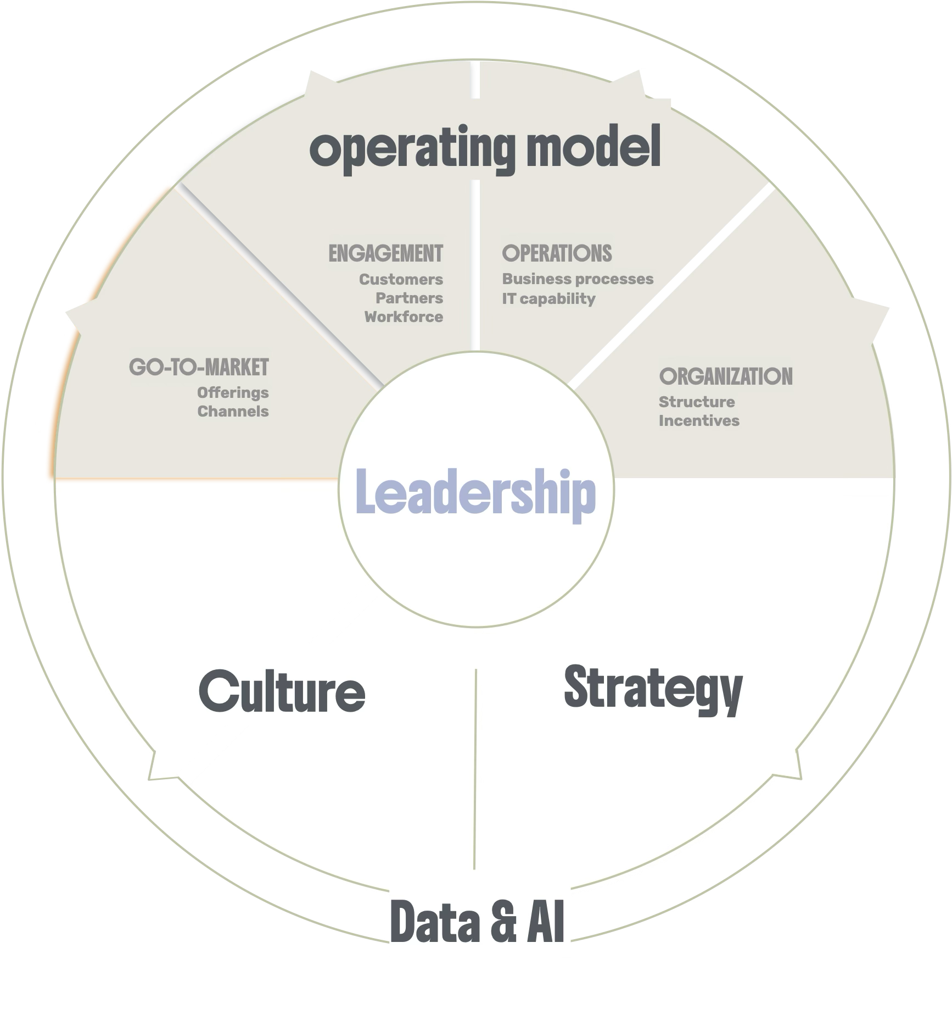

Slide 5
Other stakeholder interview questions
@Pieter / Patrick: Please note down any other questions that come to mind on this page

Slide 6
Overview of stakeholder interviews
Tobias (Procurement)
Jetske (Vattenfall IT)
Fanny (MCO)
Annemarie (S&O Germany)
Alied (S&O NL)
Henrik (S&O Sweden)
Fabian (BU leader)

