Slide 1
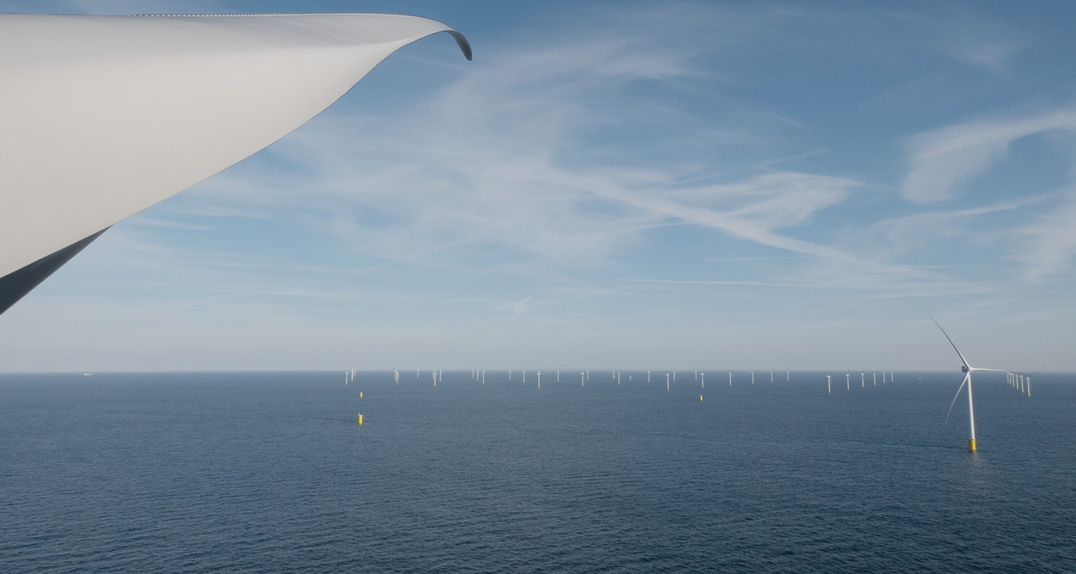
Working for fossil freedom
Insert a new image
If there is already an image in the image holder, you need to delete the existing one before inserting a new image. Failure to do so may change the format of the frame.
Since the image icon is under the title text – select the image placeholder (click on the outer edge of the placeholder). On the Insert tab, in the Images group, click Pictures and then click This Device. In the dialog box that opens, browse to the picture that you want to insert, click that picture, and then click Insert.
If the background image is placed over the text – right-click the slide and choose Reset Slide.
Our IT strategy & targets for 2025

Slide 2




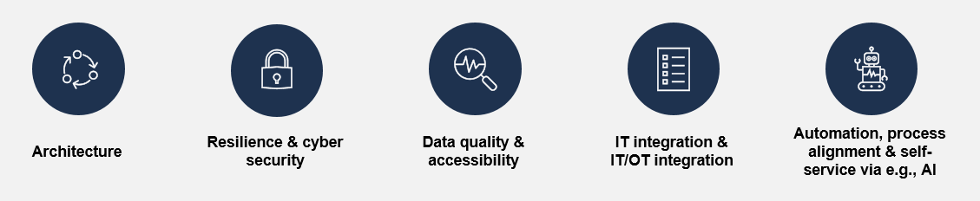
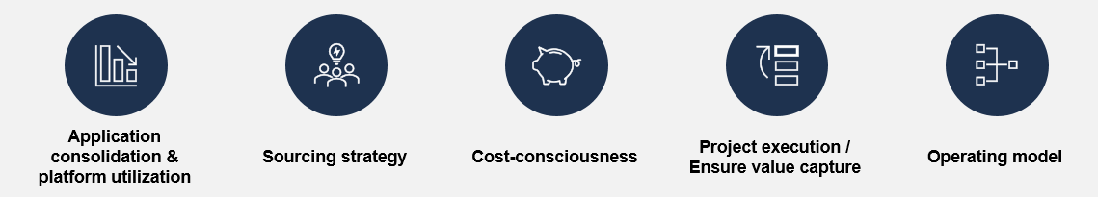
Ensure IT value creation through defined PA and KPIs for 2025
measuring execution of IT
Capturing Opportunities of a changing energy landscape
Maximize value in today’s business objectives
Driving decarbonisation
with our customers &
partners¹
Delivering
high-performing
operations
Securing a fossil-free
energy supply²
Connecting and optimizing the energy system³
Empowering
our people
Value
0) Productivity
1) Excel in Customer Experience
2) Optimize Asset Utilization,
Minimize Risks
3) Generate New Digital Revenue
Digitalization
& Transformation
Learning
Culture,
Attractive
Employer
IT Strategic
Objectives
Sustainable IT
Security
& Stability
Cost
Performance
Business
Centricity
Digital
Enablement
/ Cost Mgmt
Change Management
2025
IT4IT Data Quality
Strategic Workforce Planning
Project
Execution
Operating model
& Culture
PA
/ KPI

Slide 3

IT represents a key enabler of excellence through digitalization – but also a cost to be carefully managed
IT as an enabler and a cost to be managed
IT and Digitalization as an enabler for excellence
IT as a cost to be managed
Key value pools for Vattenfall:
Enable asset optimization
and flexibility
Increase asset availability
Enable digital products
in B2C & B2B
Enable operation risk management
Decrease opex by automation and self-service
Decreased capex by analytics
Key value pools for Vattenfall:
Process and application consolidation
Volume optimization
Project execution
Optimization of sourcing
Economies of scale
IT

Slide 4





HOW: Acting in a more coordinated and aligned way for digital enablement – 5 key domains
Coordination for IT as an enabler
Architecture
Resilience & cyber security
Data quality & accessibility
IT integration &
IT/OT integration
Automation, process alignment & self-service via e.g., AI
Establish end-to-end process and application target architectures of key domains (e.g., meter-to-cash process, asset optimization, etc.)
Ensure adherence to target architecture
Ensure the implementation of target architecture, proven vendor, and resource planning for robust, scalable, and sustainable solutions
Maintain IT hygiene accordingly and ensure business continuity
Ensure data accessible across Vattenfall¹
Ensure data quality and master data
Leverage VAP platform
Implement Group data governance
Ensure modern integration according to target architecture leverage group platforms
Ensure necessary IT / OT integration according to target architecture
Strive for automation & self-service leveraging by technologies like AI or RPA
Ensure customer and user experience
Process alignment across Vattenfall is a pre-requisite
1) According to unbundling regulations

Slide 5





HOW: Acting in a more coordinated and aligned way for cost management – 5 key areas
Coordination for IT as a cost to be managed
Application consolidation &
platform utilization
Sourcing strategy
Cost-consciousness
Project execution / Ensure value capture
Operating model
Consolidate towards and utilize Group platforms
New IT solution selected according to decided target architecture and in coordination with VIT
Actively consolidate and simplify applications
Define a sourcing strategy in collaboration with VIT and Procurement
Optimize sourcing based on a 3-year roadmap
Centralize sourcing of IT resources to leverage economic scale, for example, by utilizing Polish resources
Ensure strengthened awareness of cost of services delivered
Continuous optimization of volume (like cloud consumption, software license)
Always utilize the attitude “if it would be your own" to ensure personal responsibility & ownership
Ensure project readiness incl. requirement management, verified information classification
Change management
Ownership of stakeholders
Resource availability
Proven value creation through use of efficiency KPIs
Adherence to governance and operating models
Address redundancies
Missing roles
Clarify decision-making to prevent indecisiveness and ensure effective decision-making

